Slide 1
Fragmentation of meteoroids
19.-22. 9. 2024
IMC 2024 Kutná Hora, Czech Republic
Mgr. Mária Paprskárová Supervisor: doc. Juraj Tóth
Comenius University in Bratislava, Slovakia

Slide 2
Motivation for our work
Our goal is to infer physical characteristics of captured meteors
Information solely from the meteor (luminous) phase: light curve shape and dynamics (in case of multi-station observation)
Focus on fragmentation and ablation processes strongly connected to the light emission, material and inner structure of meteoroids
Better knowledge of meteoroids → improved strewn field estimate – possible verification of our model

Slide 3
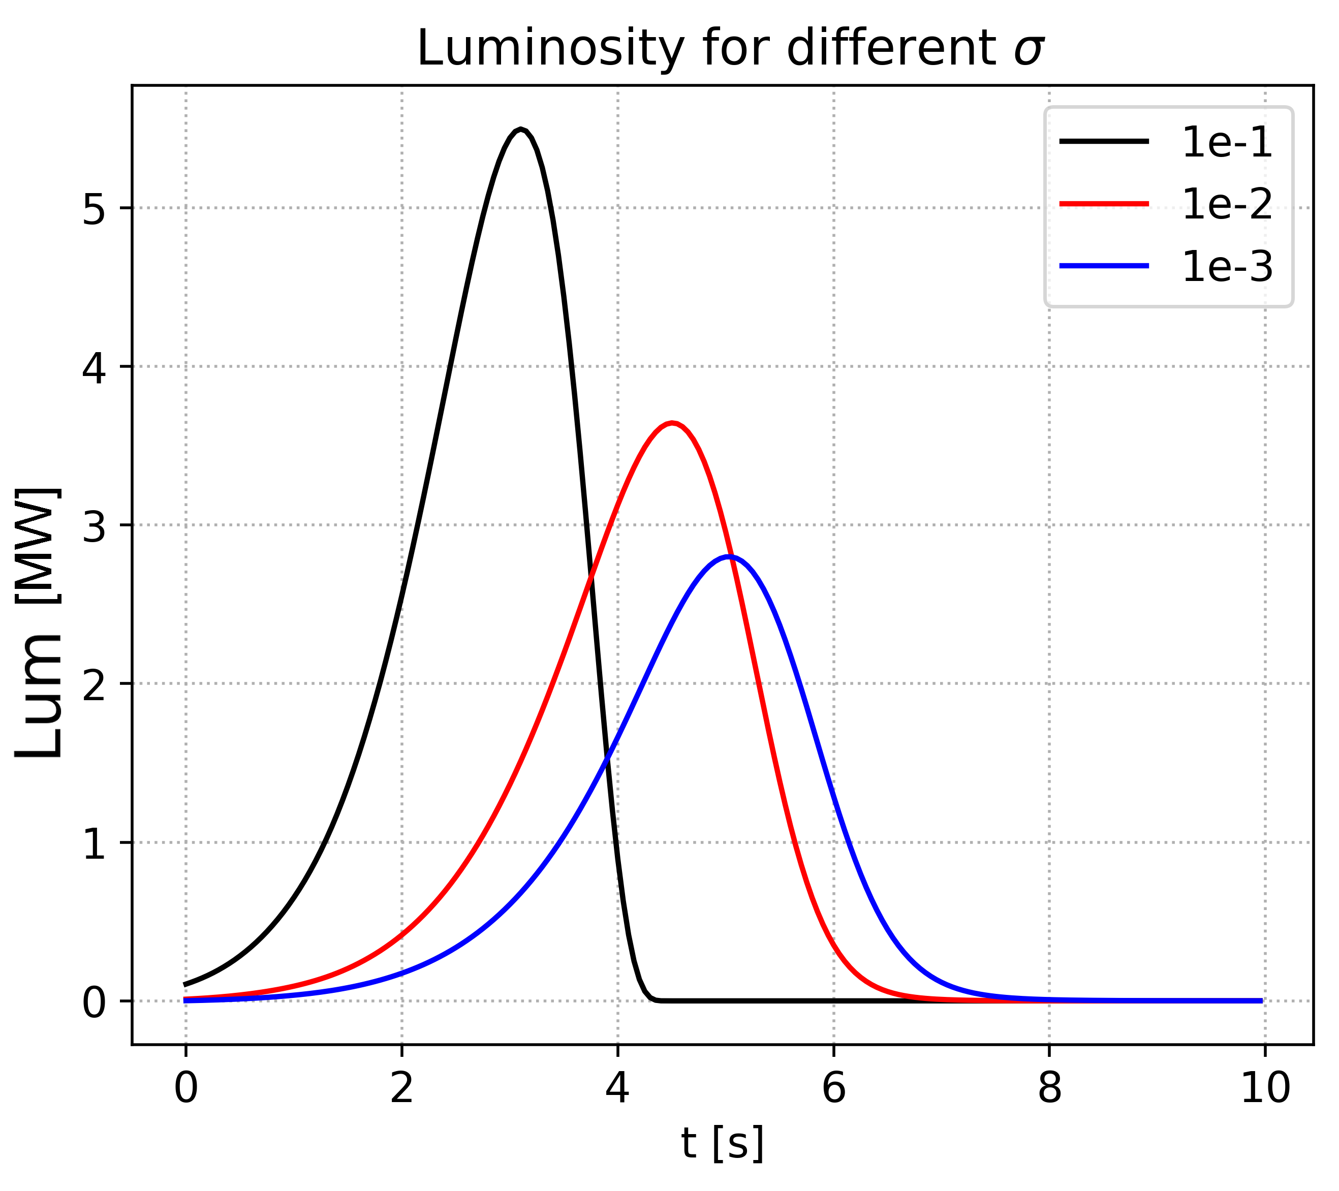
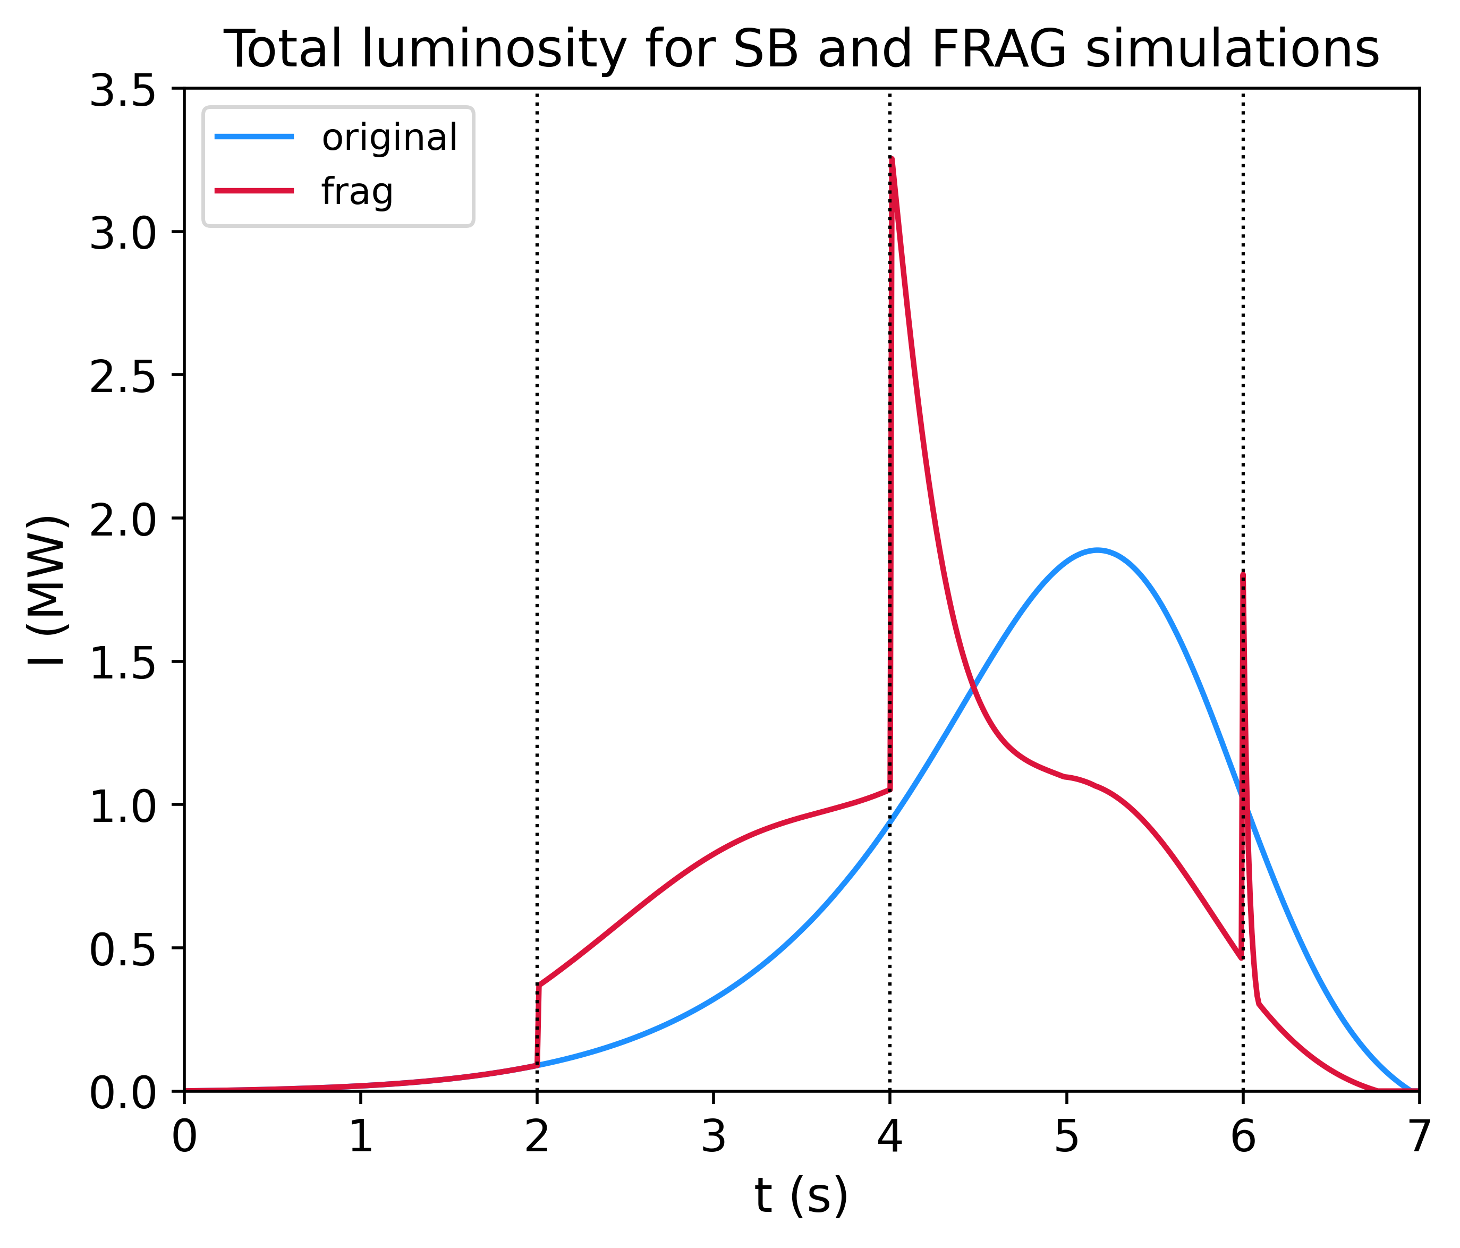
Ablation and fragmentation
Continuous mass loss from the surface of the meteoroid caused by its heating (melted and evaporated particles)
Rate given by ablation coefficient σ [kg/MJ], varies with meteor type (cometary/asteroidal)
Abrupt or quasi-continuous detachment of material on macroscopic level
Fragments continue on their own trajectory, undergoing further braking and ablation
Additional surface area exposed to the atmosphere
[kg/MJ]
Sb
frag
Notes:
Cometary – more volatile constituents, asteroidal not so easy to „burn“
*differential ablation – connection to fragmentation

Slide 4
Our model
Follows the whole atmospheric flight
Differential equations for deceleration, ablation, and light emission (ceases for dark flight under at speeds under 3 km/s)
Single-body, or gross-fragmentation – each produced fragment simulated individually
Homogeneous spherical bodies
Includes the influence of the atmosphere (MSIS-E), wind (Wyoming University Sounding) for the dark flight
Results:
properties (mass, density, ablation rate) producing the best fit to the observation,
strewn field prediction

Slide 5
Analysed meteors
Cases captured by two or more AMOS cameras
3 asteroidal meteors strong enough to survive until they land on the ground
Fragmentation estimated from the light curve shape

Slide 6
Simulation results
z

Slide 7
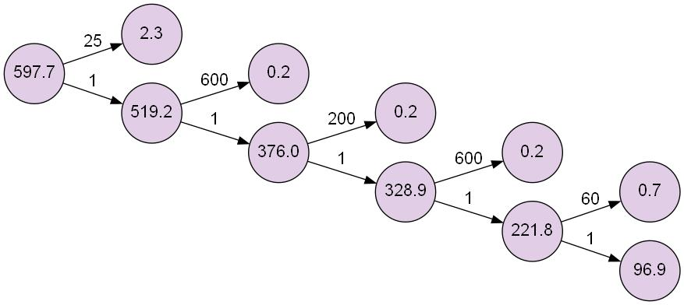
II
III
IV
I
V
Fragments‘ mass [g]
I
II
III
IV
V

Slide 8
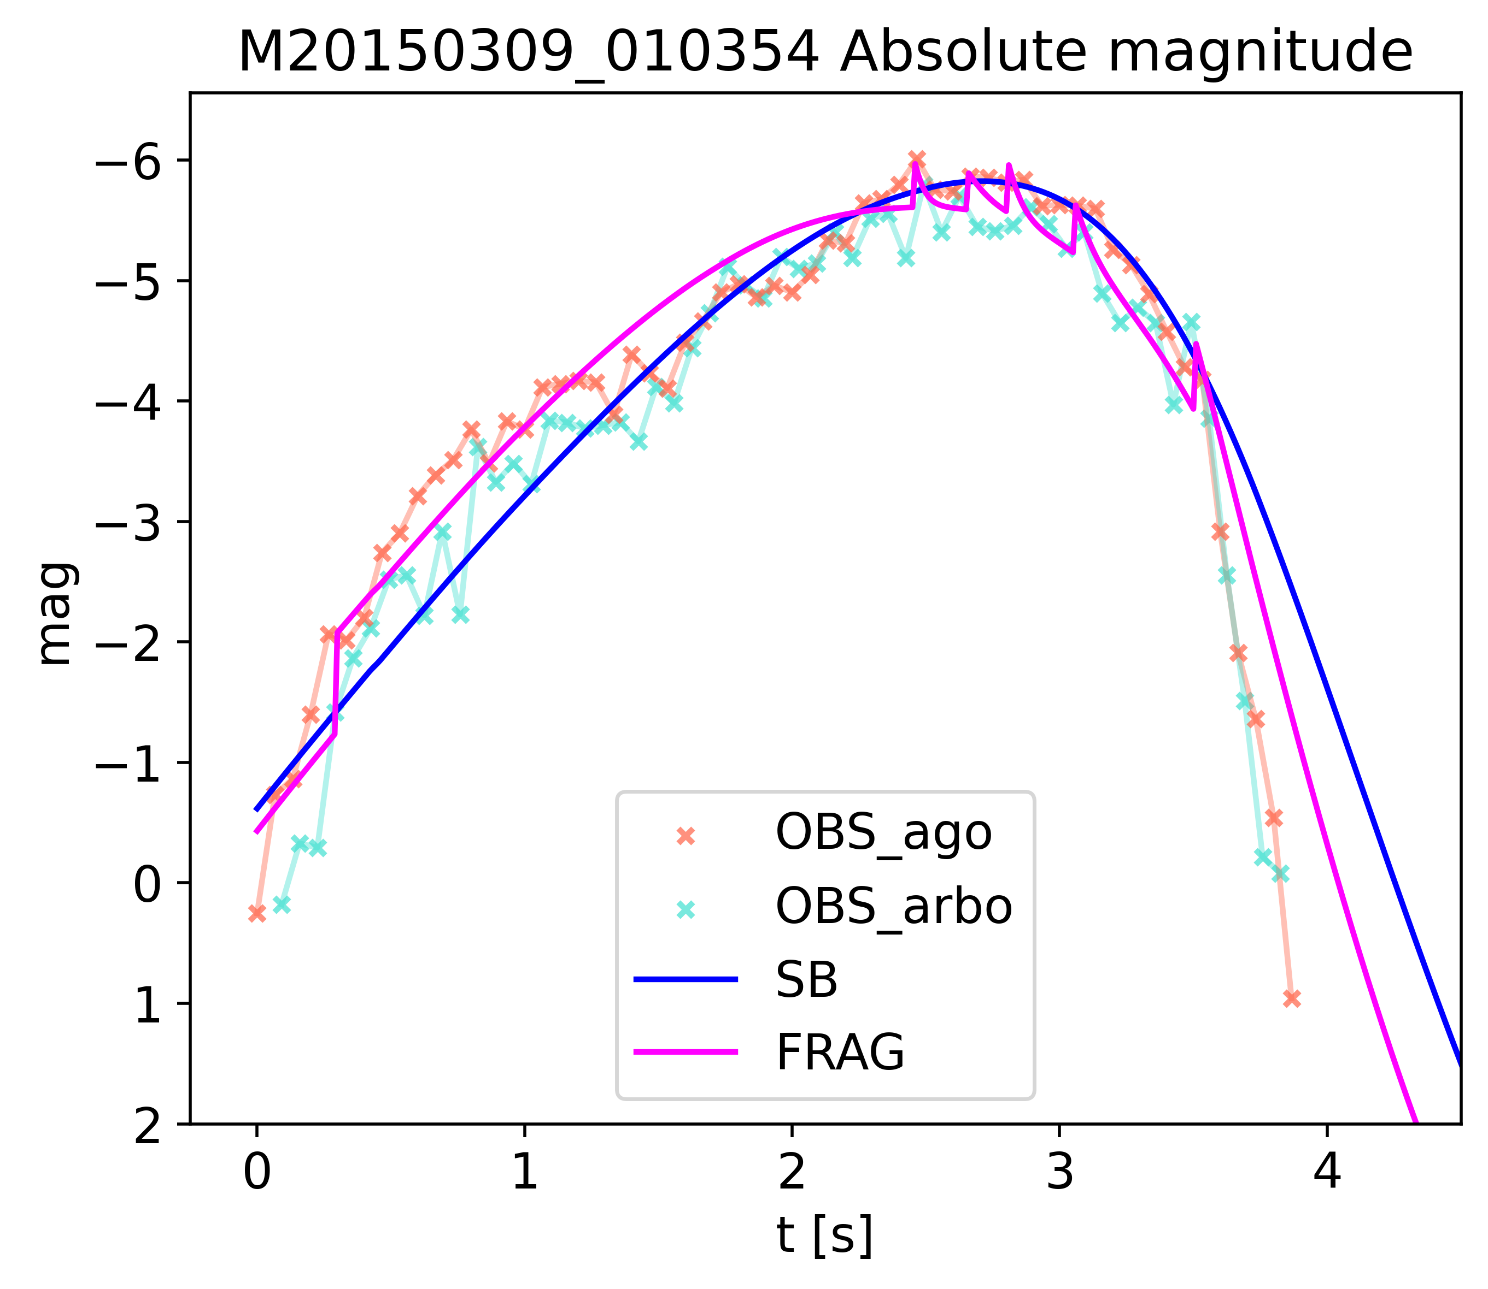
II
III
IV
V
VI
I
Fragments‘ mass [g]
I
II
III
IV
V
VI

Slide 9
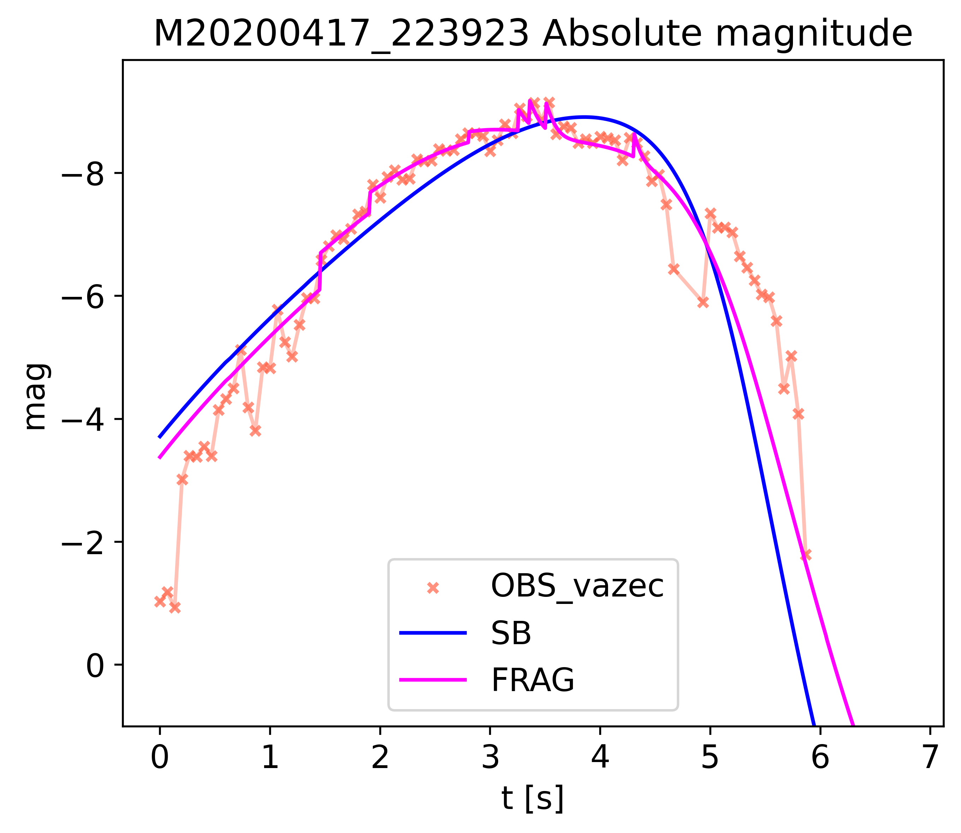
IV
V
VI
III
VI
II
I
Fragments‘ mass [g]
I
II
III
IV
V
VI
VII

Slide 10
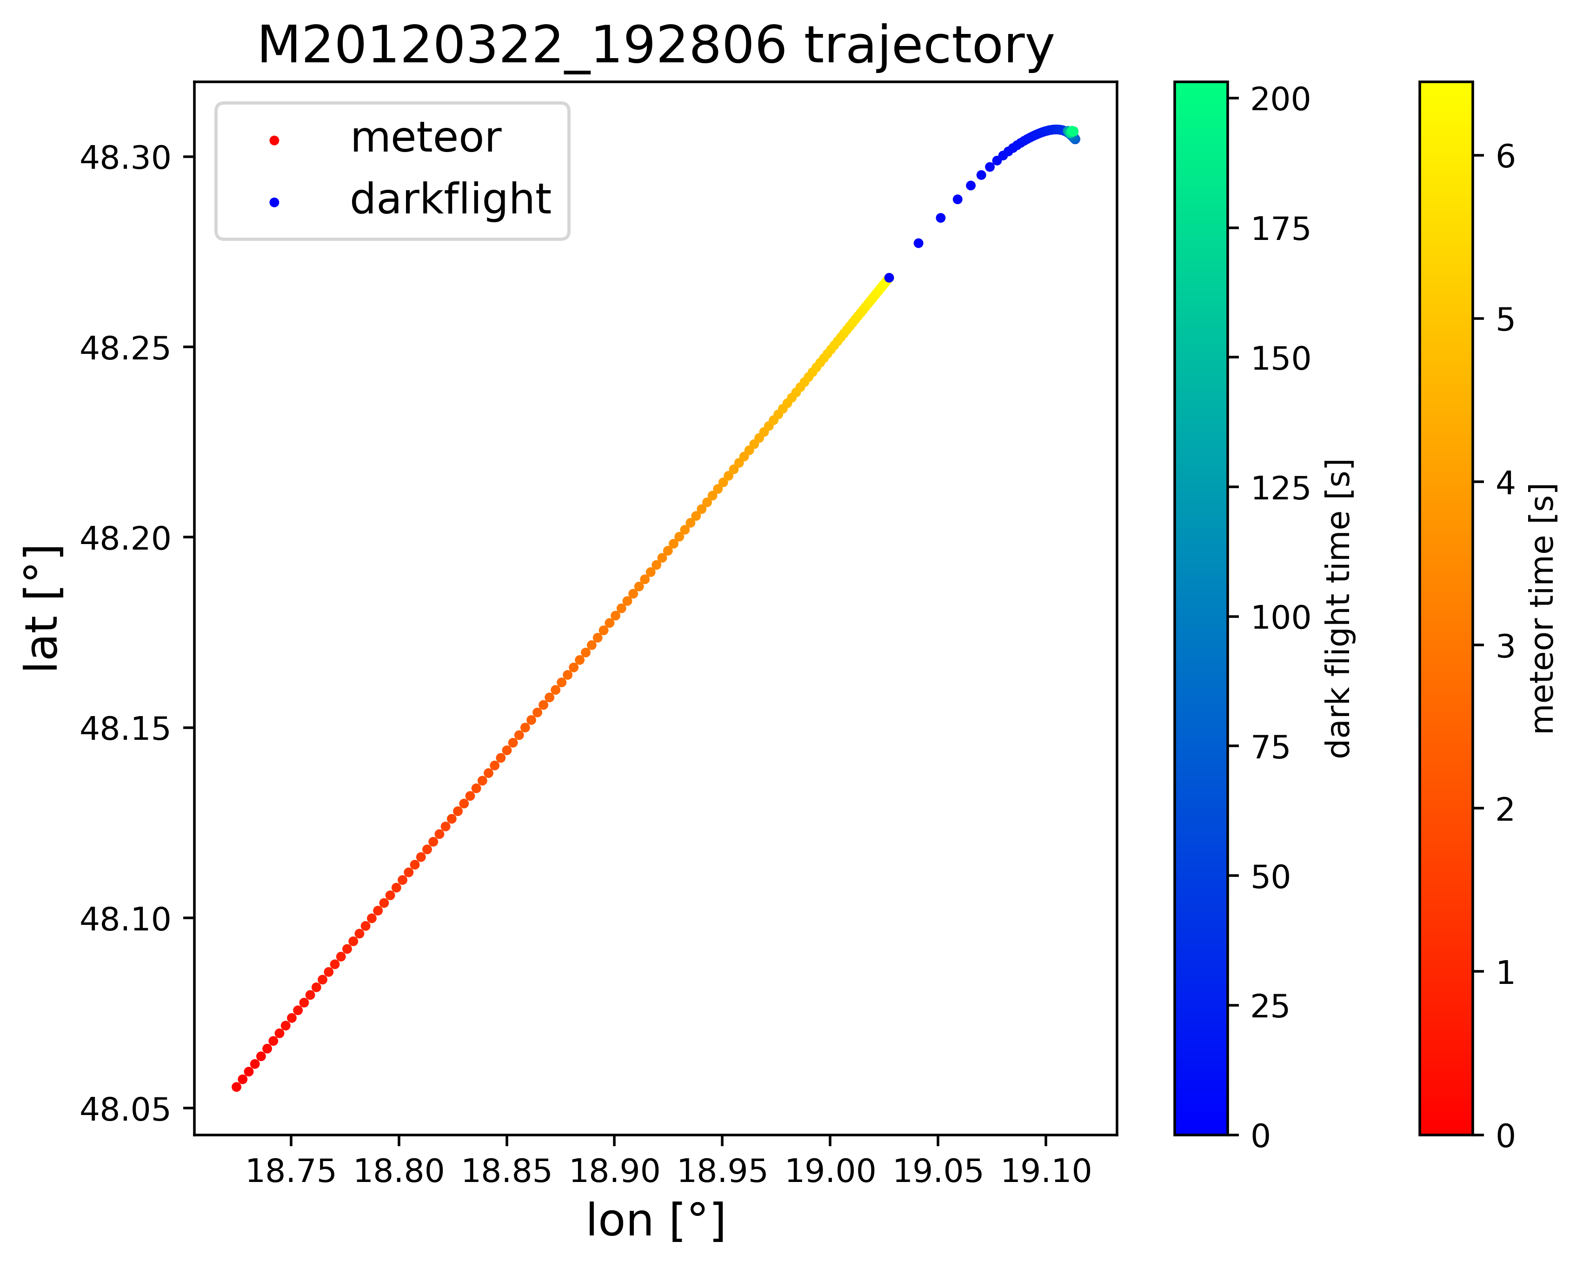
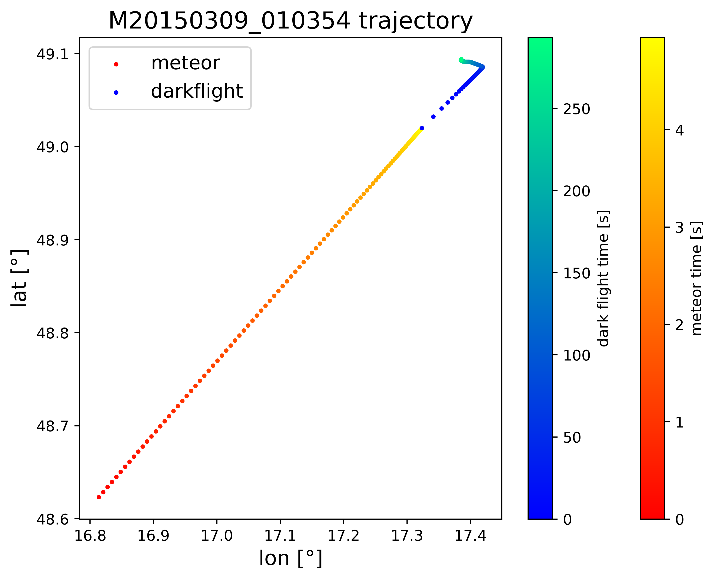
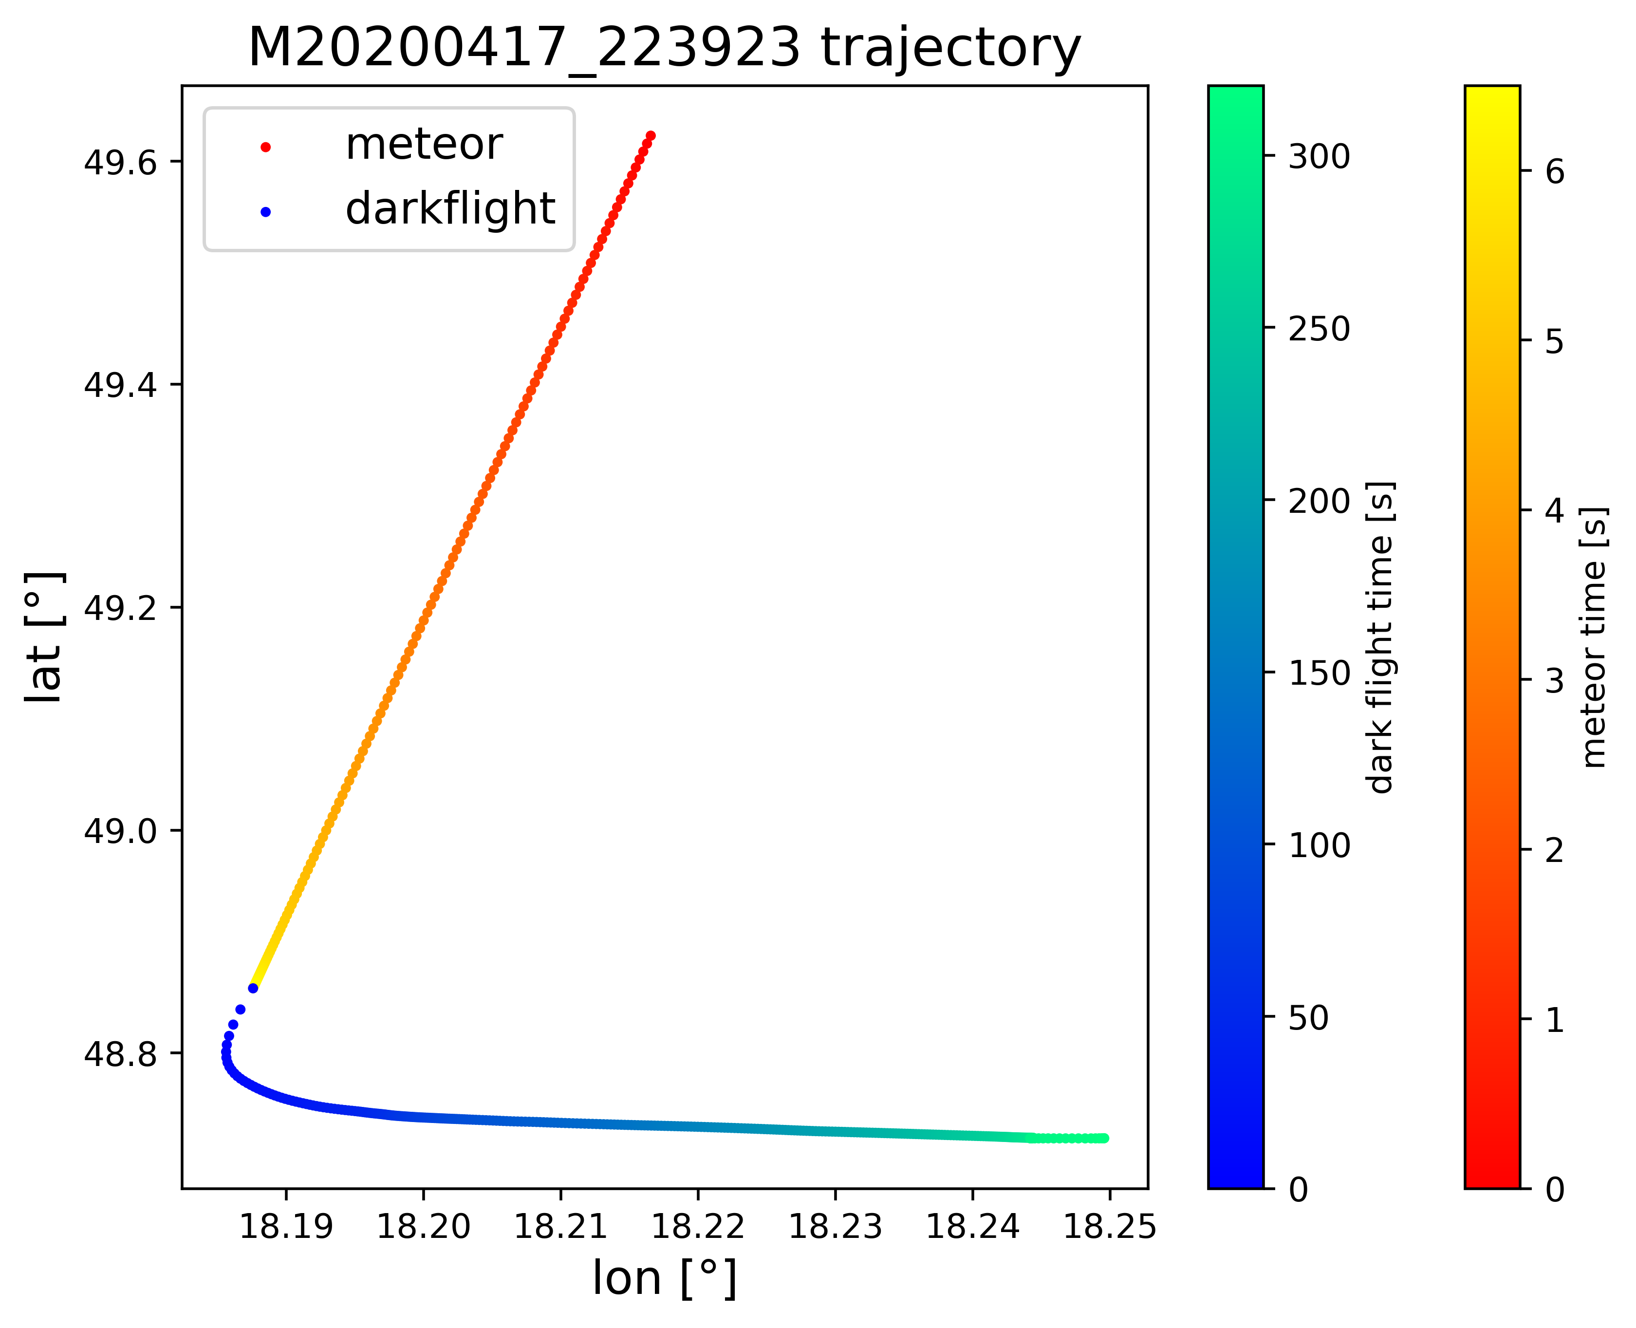
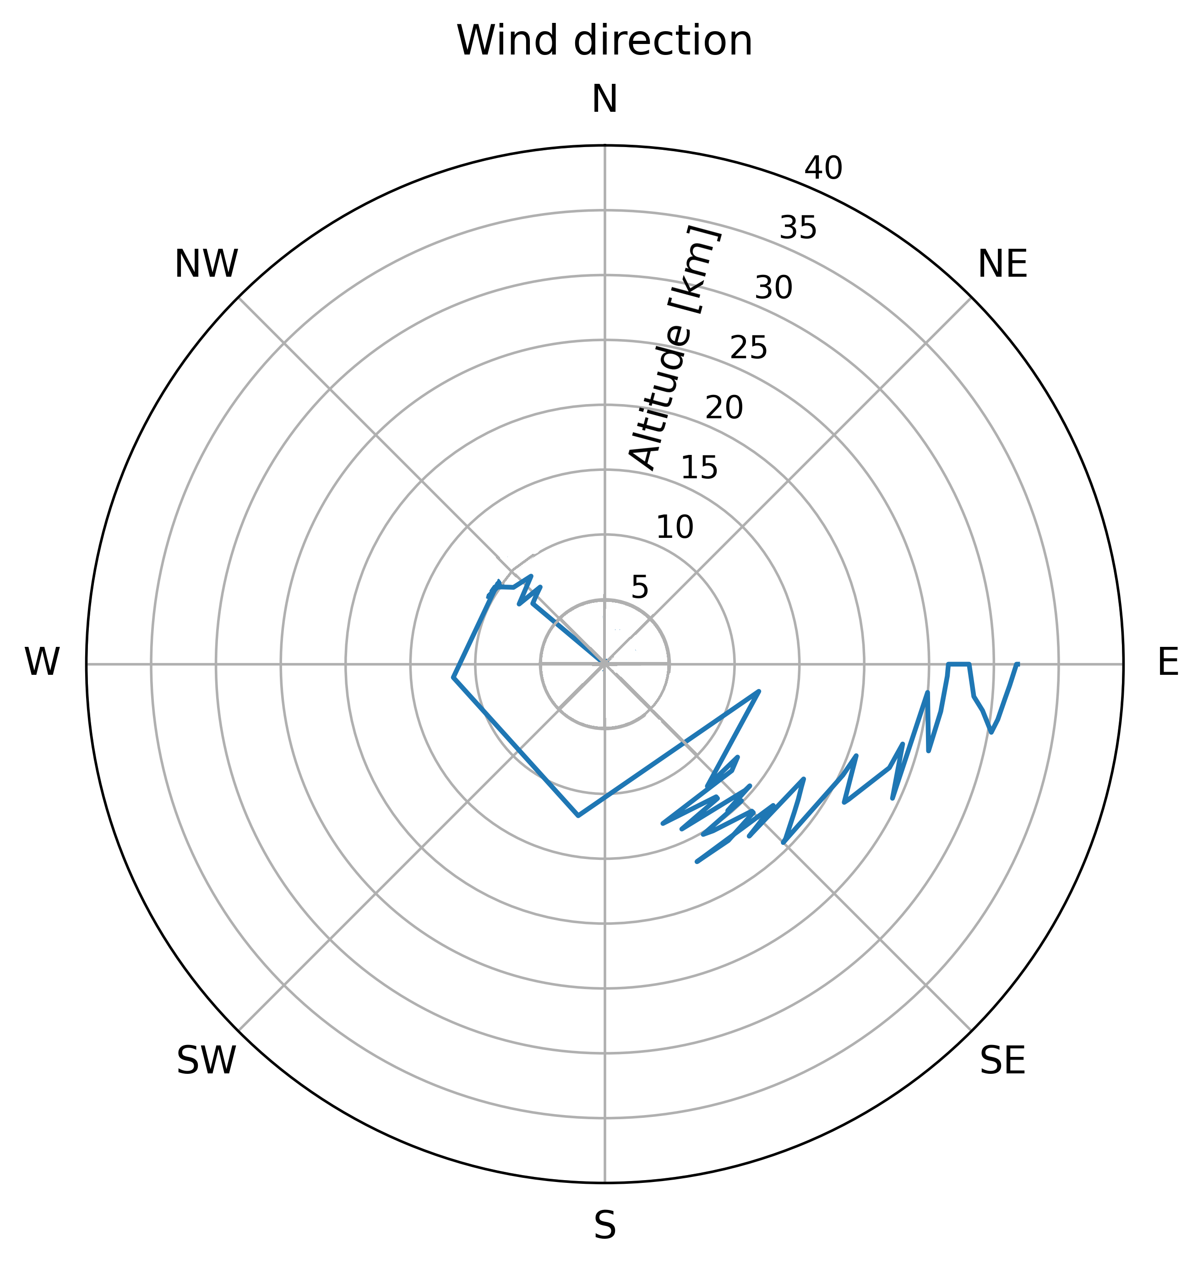
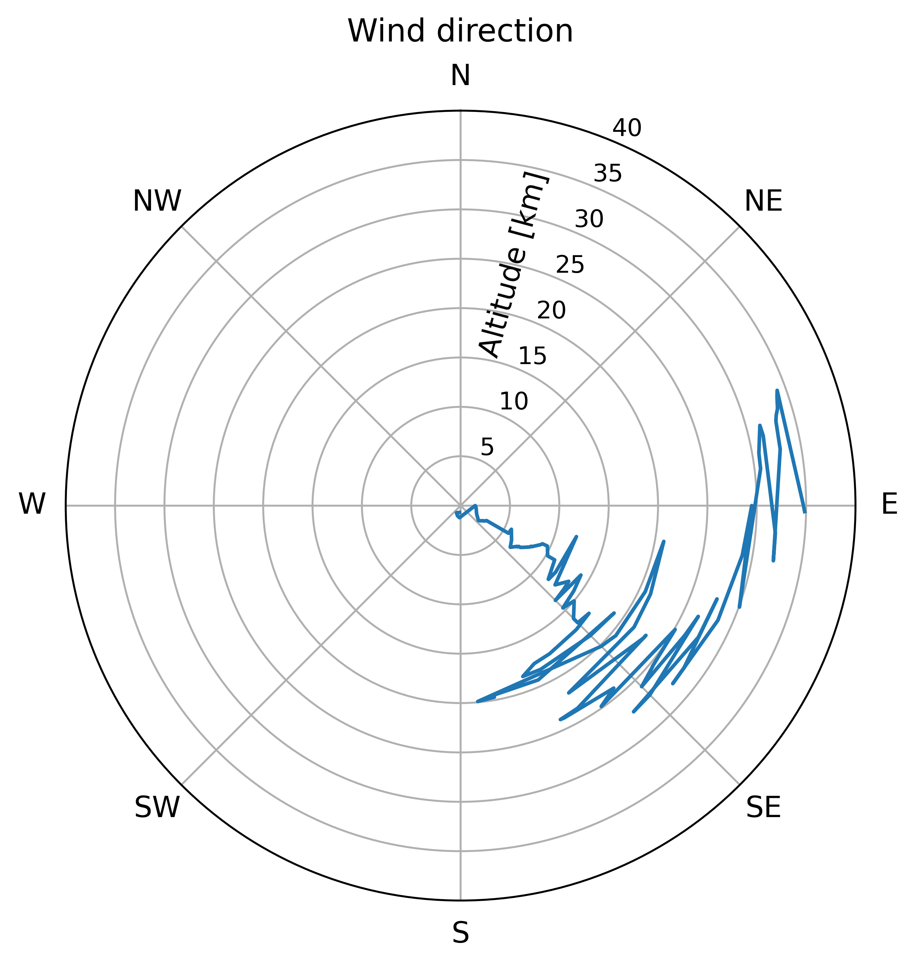
Single-body trajectory
Wind direction
Wind direction

Slide 11
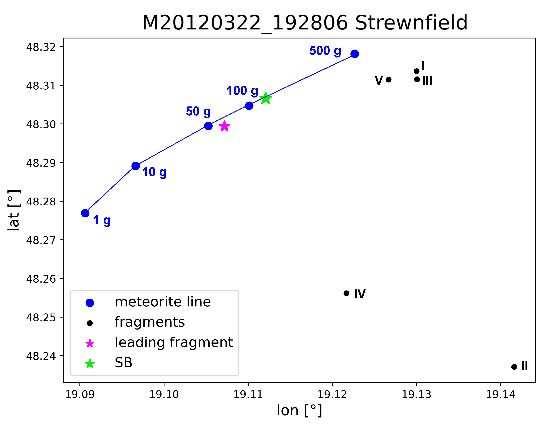
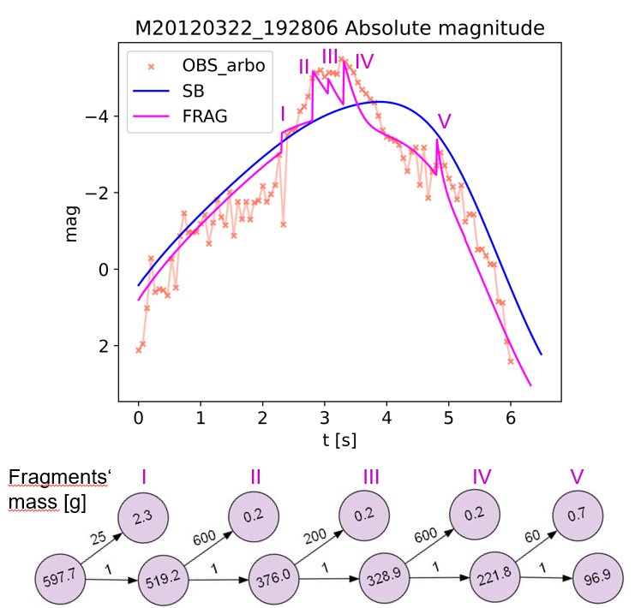
Strewn field
Single-body 131 g leading fragment 67 g fragments 0.1 - 2 g

Slide 12
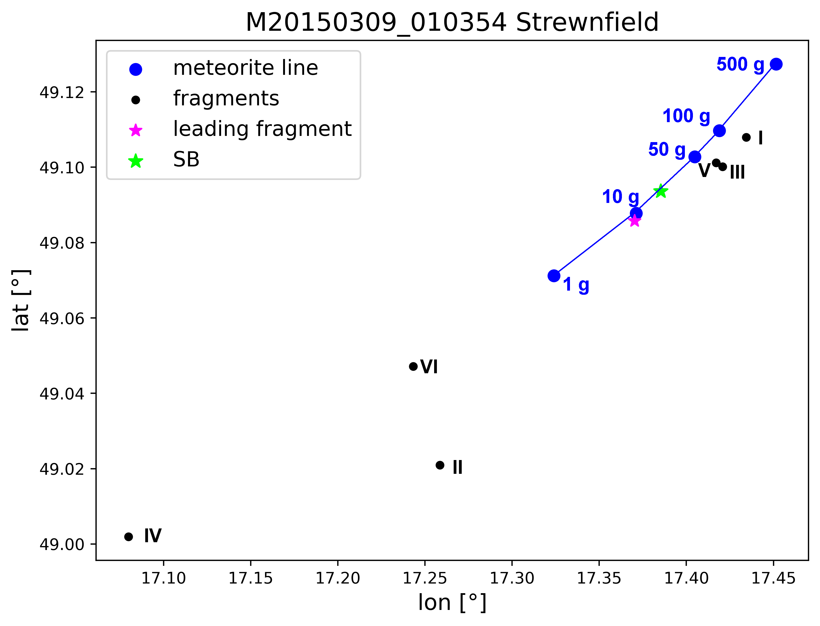
Strewn field
Single-body 19 g leading fragment 11 g fragments 0.001 - 3 g
Notes:
Uncertainty in position approx 500 m

Slide 13
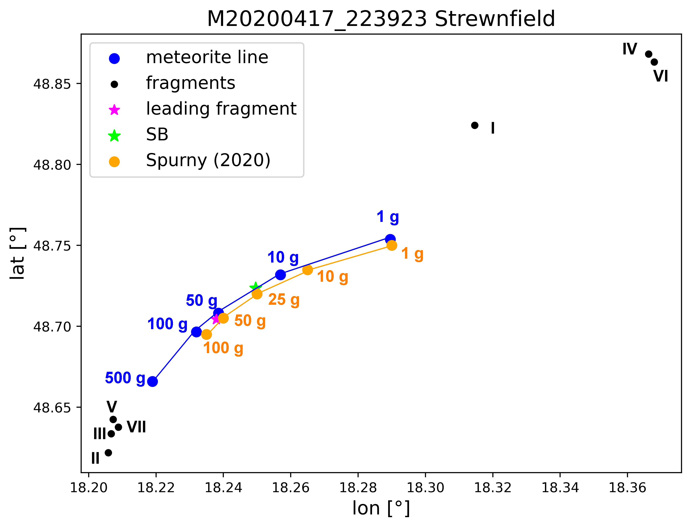
Strewn field
Single-body 19 g leading fragment 11 g fragments 0.01 - 2 g

Slide 14
Conclusions
Determined characteristics in agreement with asteroidal material
All three cases show the same trend in fragmentation along the flight
Including fragmentation restricts ablation coefficient, improves the light curve fit, does not disrupt the dynamics fit
Strewn field from single-body approximation differs significantly from estimate made using fragments - leading fragment follows the meteorite line, others mostly affected by the wind

Slide 15
Thank you for your attention!

Slide 16
Literature
Z. Ceplecha, J. Borovička, W.G. Elford, et al. Meteor Phenomena and Bodies. Space Science Reviews, 84(3/4):327–471, 1998.
J. Borovička, P. Spurný, and L. Shrbený. Two Strengths of Ordinary Chondritic Meteoroids as Derived from Their Atmospheric Fragmentation Modeling. The Astronomical Journal, 160(1):42, June 2020.
J. Borovička, J. Tóth, A. Igaz, et al. The Košice meteorite fall: Atmospheric trajectory, fragmentation, and orbit. Meteoritics & Planetary Science, 48:1757 – 1779 (2013).
M. Baláž. Determination of Total Meteoroid Flux in Milimetre to Metre Size Range. Master Thesis, Univerzita Komenského v Bratislave, 2018.
K. Havrila. Dynamika preletu meteoroidov a prachových častíc planetárnou atmosférou. Disertation Thesis, Univerzita Komenského v Bratislave, 2022.

